Slide 1
Meeting National Objectives with CDBG
Washington, DC - February 4, 2026
Heather Johnson, AICP - Davenport, IA

Slide 2
What makes an activity eligible for CDBG?
To be eligible, an activity must:
Meet a National Objective
Be an eligible activity
With eligible costs
For an eligible beneficiary

Slide 3
What are National Objectives?

Slide 4
What is CDBG? Who benefits?
Established by Congress in 1974.
Provides annual grants to cities, counties and states to develop strong communities by providing decent housing, a suitable living environment, and expanding economic opportunities, principally for low- and moderate-income persons.

Slide 5
National Objectives
Set by Congress
Every applicant must meet at least one:
Low and Moderate Income Benefit
Direct programs and services to individuals, or physical/infrastructure/economic development in low mod income areas.
Prevention and Elimination of Slums and Blight
Physical improvements to alleviate slum/blight conditions, generally in designated areas.
Urgent Need
Response to emergency needs, generally a national disaster.

Slide 6
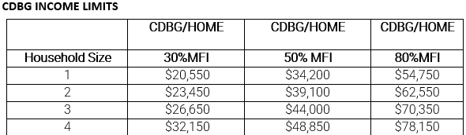
National Objective: Low Mod Benefit
Benefit extremely low-, low-, and moderate-income households and individuals which in Davenport are defined as follows for the current program year (subject to change):
Certain public services activity may also be “Presumed benefit”:
Benefits clientele that are generally presumed to be extremely low, low, or moderate income such as abused children, battered spouses, elderly persons, handicapped persons, homeless persons, illiterate persons, persons living with AIDS, and migrant farm workers. Racial and ethnic demographics must still be collected.

Slide 7
National Objective: Slum and Blight
Aid in the prevention or elimination of slums or blight
limited to activities designed to eliminate specific conditions of blight or physical decay on an area or spot basis.
Spot basis: single location, not it a designated slum blight area
Area basis: in an area designated as a slum/blight area under state/local law, with defined boundaries and documented conditions of blight. Areas must be recertified every 10 years.
Ways to address slum blight:
limited to acquisition, clearance, relocation, historic preservation, and/or rehabilitation
limited to the extent necessary to eliminate specific conditions detrimental to public health and safety.
Activities carried out under Slum/Blight do not count towards the requirement to expend at least 70% of funds to benefit LMI residents.

Slide 8
National Objective: Urgent Need
Meet community development needs that are urgent due to conditions that pose a threat to public health or welfare.
These are typically in response to a major disaster, such as a flood, hurricane, tornado, wildfire, etc.
Limited to the extent necessary to eliminate specific conditions detrimental to public health and safety.
Activities carried out under Urgent Need do not count towards the requirement to expend at least 70% of funds to benefit LMI residents.

Slide 9
How to determine if something is eligible?

Slide 10
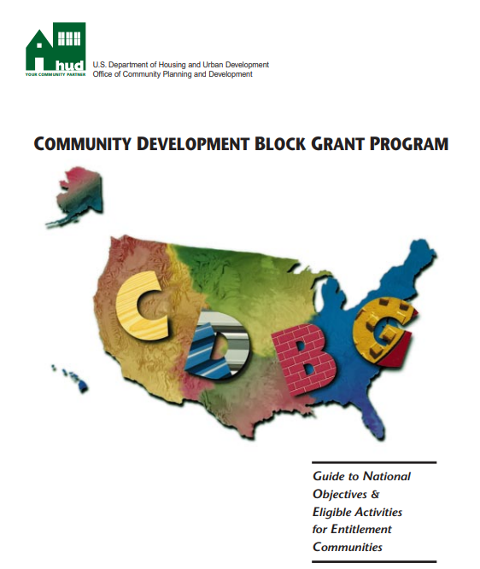
Does it meet a national objective?
HUD provides a guide with examples:
Guide to National Objectives and Eligible Activities for Entitlement Communities
https://files.hudexchange.info/resources/documents/CDBG_Guide_National_Objectives_Eligible_Activities.pdf
Lays out six step process for determining eligibility.

Slide 11
Don’t forget about IDIS!
All activities will eventually be entered in IDIS
Their characteristics will need to “fit” withing the IDIS matrix codes and accomplishment types.
IDIS matrix codes and accomplishment types can be used to help determine if an activity meets a national objective!
HUD provides guides to help tie matrix codes, accomplishment types, and national objectives together:

Slide 12
Key Reference Links
Appendix A - Matrix Code Definitions: https://files.hudexchange.info/resources/documents/Matrix-Code-Definitions.pdf
Appendix B - National Objective Code Descriptions: https://files.hudexchange.info/resources/documents/National-Objective-Code-Descriptions.pdf
Appendix C - Combination Reference: https://files.hudexchange.info/resources/documents/Matrix-Code-National-Objective-Accomplishment-Type-Combinations-Table.pdf
Quick Reference Table: https://files.hudexchange.info/resources/documents/Matrix-Code-National-Objective-Table.pdf

Slide 13
Example
Often, a request to determine eligibility starts with a very specific request
For example, sometimes an elected official will request that a specific property be demolished.
Let’s use HUD tolls to work backwards from a very specific request (demolish a single property) to the general concept of national objective.
Remember, an activity is only eligible if it:
Meets a national objective
Is an eligible activity
With eligible costs
For an eligible beneficiary

Slide 14
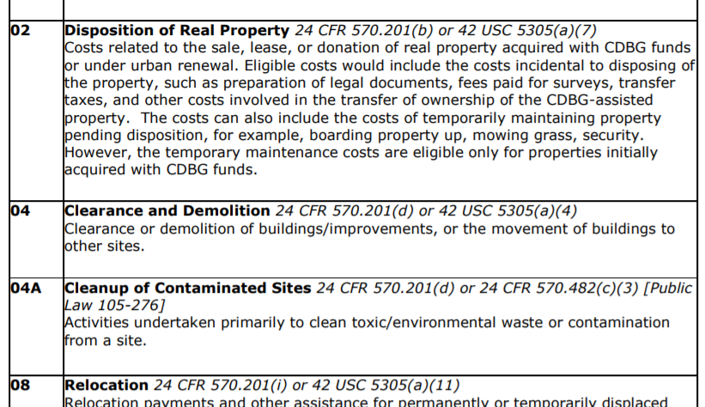
Demolition Example (Appendix A)
Start with Appendix A to find a Matrix Code that seems to fit.

Slide 15
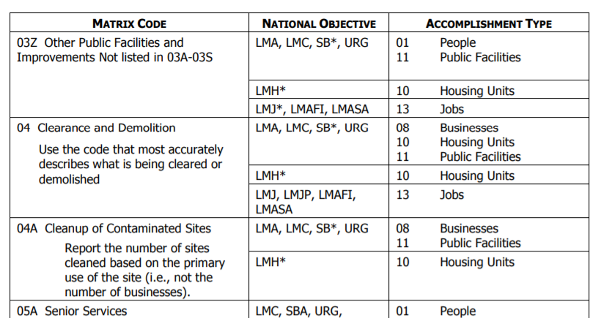
Demolition Example (Appendix C)
Look to Appendix C to see which National Objectives & accomplishment types you could use

Slide 16
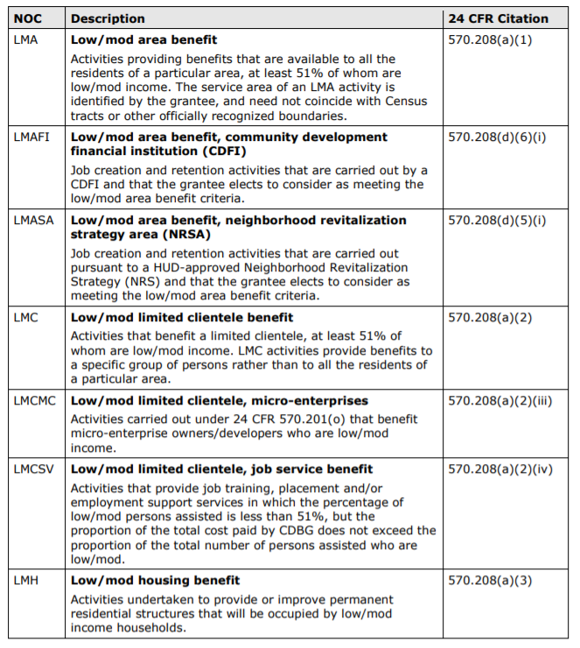
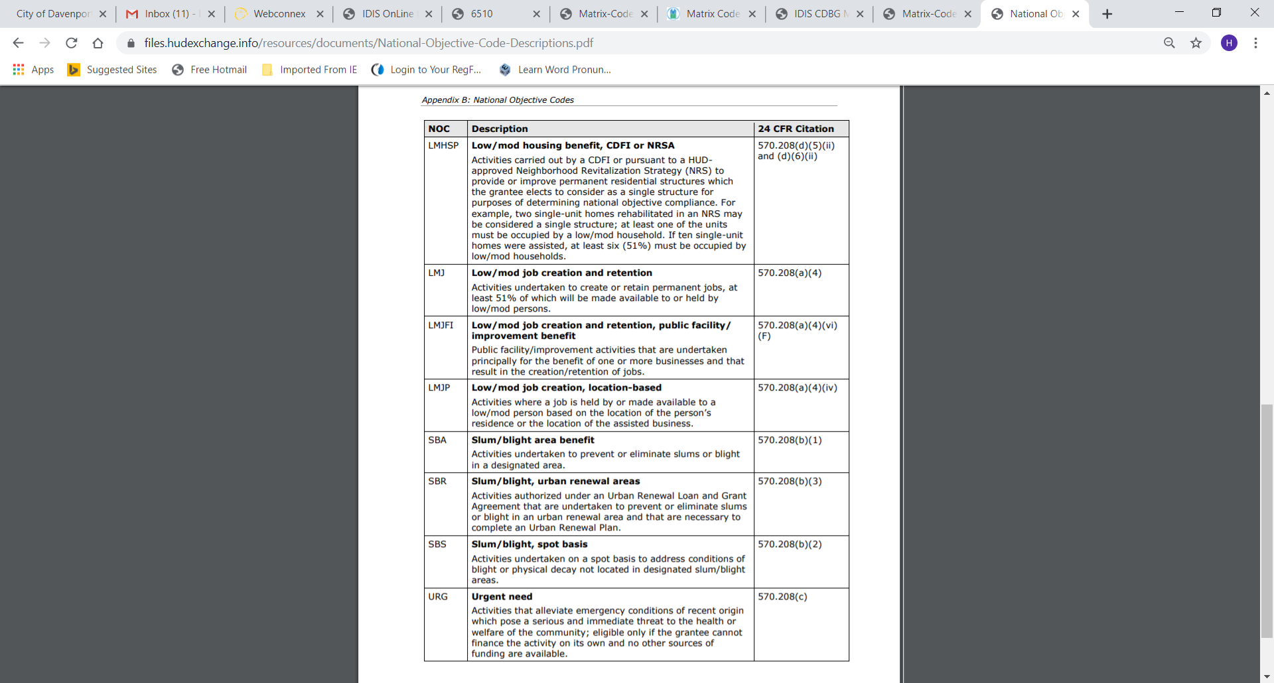
Demolition Example Appendix B
Check Appendix B to see which of the National Objectives fit

Slide 17
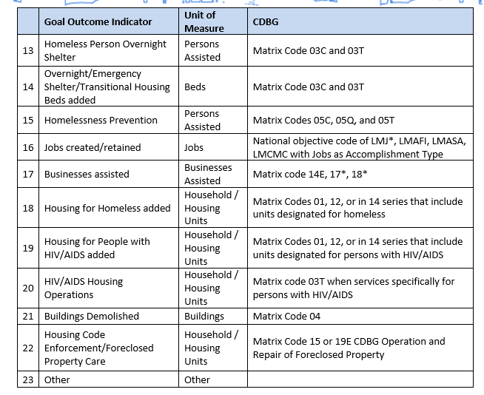
Demolition example goal outcome indicators
Look in the ConPlan Desk Guide for a GOI/Matrix code cross reference table
Notes:
Key takeaway: you have to be conscious of the GOI from the beginning, BEFORE you do your plan or enter any activities.

Slide 18
Questions?
Heather.johnson@davenportiowa.com

